Slide 1




Project Name
SEMPITERNAL
LEAVES

Slide 2
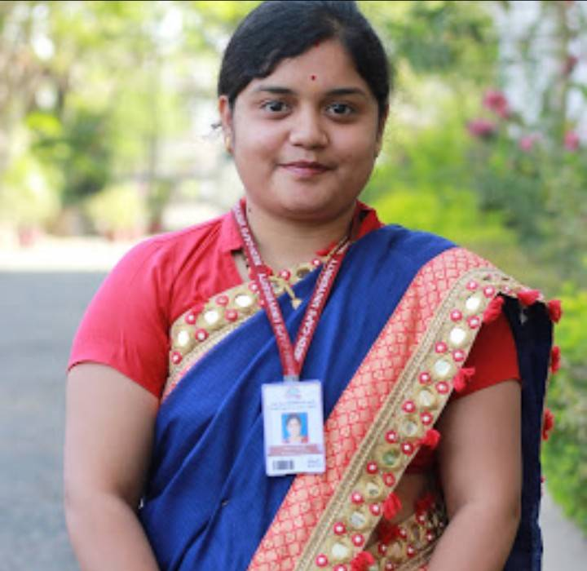
Team Mentor
Team Members
Lucky Kulshrestha
Shreya Agrawal
Priyashi Kumari
Kalash Kalwani
Ritik Rizwani
Ms. Jyoti Kukade

Slide 3



Slide 5


CONTENTS
PROBLEM STATEMENT
WORKFLOW
TECHNOLOGY
WEB-INTERFACE
DATASET
FUTURE USAGE
WHY WE CHOOSE WEB SERVICE AS A SOLUTION ?

Slide 6

ZERO HUNGER ?

Slide 7
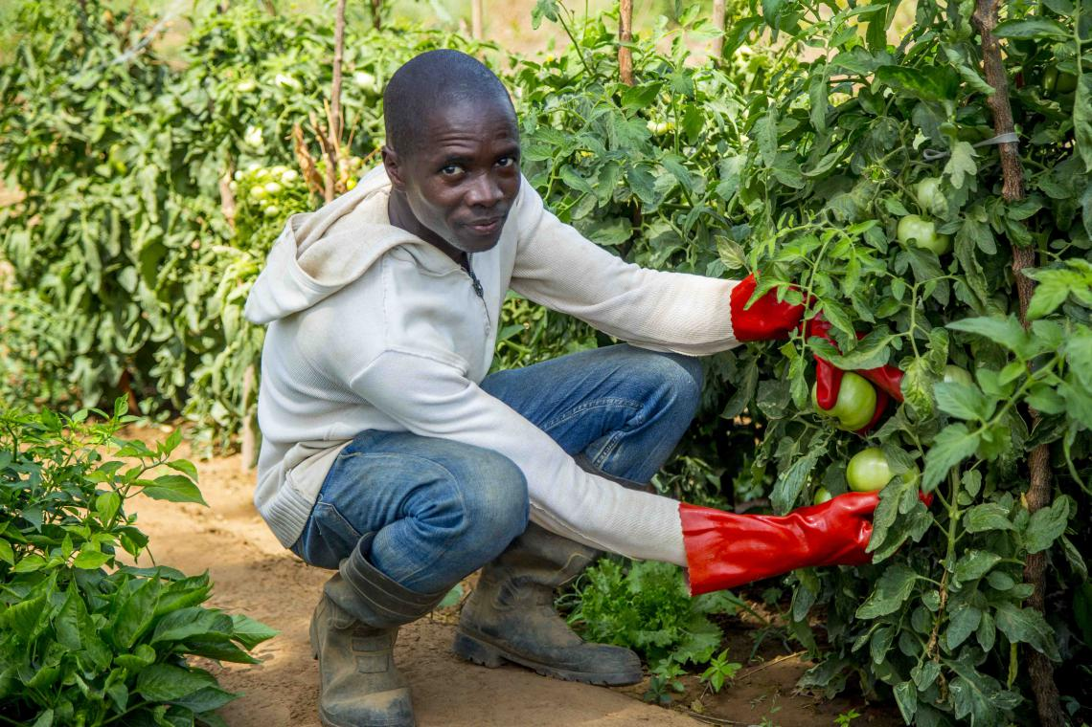

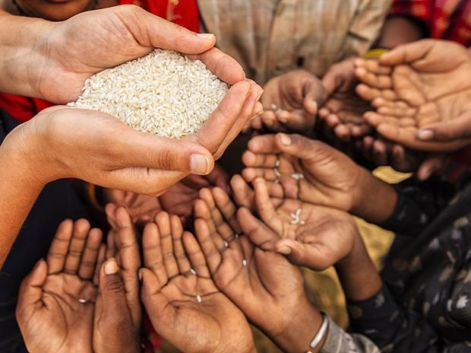

Slide 8
PROBLEM STATEMENT
Problem:-
Approx. 9 percent of the global population is suffering from hunger and there is the issue of quality of food,and the main challenge is to get the right food to the right places with minimal time and cost.
As Much of the world’s food is grown by small-scale, independent farms and these farms suffer from the problem like crop disease.
Solution:-
If we can tackled this problem at initial stage then there is possibility of producing healthy crop.
This can be achieved by using machine learning and deep learning based model, and then inspecting whether the crop is healthy or not (disease free),and if it is contaminated so getting right suggestion and advice for its treatment.
This approach can be efficacious as we will be able to predict the cause at initial stage and then we can deliver healthy food.

Slide 9
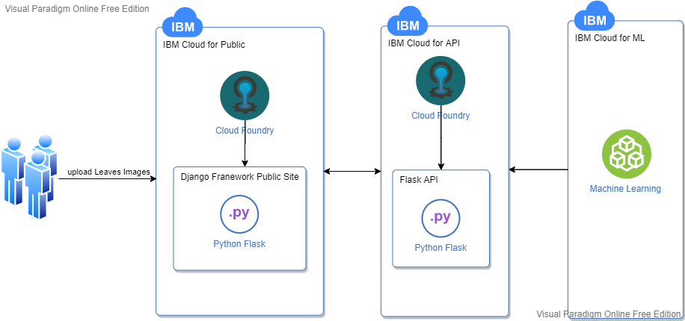
WORKFLOW
.

Slide 10
TECHNOLOGY
IBM CLOUD
It is a set of cloud computing services for business offered by the information technology company IBM. It combines platform as a service (PaaS) with infrastructure as a service (IaaS).It offers the most open and secure public cloud for business, a next-generation hybrid multi cloud platform, advanced data and AI capabilities, and deep enterprise expertise.
services offered by ibm cloud-
Compute,Containers,AI,Storage,Database,Network and security.

Slide 11
Continue..
IBM Cloud Machine learning
Watson Machine Learning is a service on IBM Cloud with features for training and deploying machine learning models and neural networks.
Watson Machine Learning enables you to build, train, deploy, and manage machine learning and deep learning models.
Watson Machine Learning supports popular frameworks, including: TensorFlow, Caffe, PyTorch, and Keras to build and deploy models.
Dynamically retrain models with continuous learning.
Bring any projects into production, including open source, third-party and IBM tools.

Slide 12
Continue..
Django
It is a Python-based free and open-source web framework that follows the
model–template–views (MTV) architectural pattern.
Django's primary goal is to ease the creation of complex, database-driven websites.
The framework emphasizes reusability and "pluggability" of components, less code,
low coupling, rapid development, and the principle of don't repeat yourself.

Slide 13
DATASET
Training set
A training dataset is a dataset of examples used during the learning process and is used to fit the parameters of a classifier.
Validation set
A validation dataset is a dataset of examples used to tune the hyperparameters of a classifier.
Accuracy
Training accuracy of a model is 0.9696.
Validation accuracy of a model is 0.9633.

Slide 14
Continue..
Total Classified Classes :- 38
['Apple__Apple_scab', 'Apple_Black_rot', 'Apple__Cedar_apple_rust', 'A
pple__healthy', 'Blueberry_healthy', 'Cherry(including_sour)___Powdery
mildew', 'Cherry(including_sour)__healthy', 'Corn(maize)__Cercospora
leaf_spot Gray_leaf_spot', 'Corn_(maize)__Common_rust', 'Corn_(maize)_
Northern_Leaf_Blight', 'Corn_(maize)__healthy', 'Grape__Black_rot', 'Gra
pe__Esca(Black_Measles)', 'Grape__Leaf_blight(Isariopsis_Leaf_Spot)',
'Grape__healthy', 'Orange_Haunglongbing(Citrus_greening)', 'Peach___Ba
Cterial_spot', 'Peach__healthy', 'Pepper,_bell__Bacterial_spot', ' Peppe
R,bell_healthy', 'Potato_Early_blight', 'Potato__Late_blight', 'Pota
To__healthy', 'Raspberry_healthy', 'Soybean_healthy', 'Squash__Powde
Ry_mildew', 'Strawberry__Leaf_scorch', 'Strawberry_healthy', 'Tomato__
Bacterial_spot', 'Tomato__Early_blight', 'Tomato_Late_blight', 'Tomato
_Leaf_Mold', 'Tomato_Septoria_leaf_spot', 'Tomato__Spider_mites Two-sp
Otted_spider_mite', 'Tomato__Target_Spot', 'Tomato__Tomato_Yellow_Leaf_C
url_Virus', 'Tomato__Tomato_mosaic_virus', 'Tomato__healthy']

Slide 15
Continue..
Layer (type) Output Shape Param #
=================================================================
conv2d_5 (Conv2D) (None, 54, 54, 96) 34944
_________________________________________________________________
max_pooling2d_3 (MaxPooling2 (None, 27, 27, 96) 0
_________________________________________________________________
batch_normalization_8 (Batch (None, 27, 27, 96) 384
_________________________________________________________________
conv2d_6 (Conv2D) (None, 17, 17, 256) 2973952
_________________________________________________________________
max_pooling2d_4 (MaxPooling2 (None, 8, 8, 256) 0
_________________________________________________________________
batch_normalization_9 (Batch (None, 8, 8, 256) 1024
_________________________________________________________________
conv2d_7 (Conv2D) (None, 6, 6, 384) 885120
_________________________________________________________________
batch_normalization_10 (Batc (None, 6, 6, 384) 1536
_________________________________________________________________
conv2d_8 (Conv2D) (None, 4, 4, 384) 1327488
_________________________________________________________________
batch_normalization_11 (Batc (None, 4, 4, 384) 1536

Slide 16
Continue..
Layer (type) Output Shape Param #
=============================================================== conv2d_9 (Conv2D) (None, 2, 2, 256) 884992
_________________________________________________________________
max_pooling2d_5 (MaxPooling2 (None, 1, 1, 256) 0
_________________________________________________________________
batch_normalization_12 (Batc (None, 1, 1, 256) 1024
_________________________________________________________________
flatten_1 (Flatten) (None, 256) 0
_________________________________________________________________
dense_4 (Dense) (None, 4096) 1052672
_________________________________________________________________
dropout_3 (Dropout) (None, 4096) 0
_________________________________________________________________
batch_normalization_13 (Batc (None, 4096) 16384
_________________________________________________________________
dense_5 (Dense) (None, 4096) 16781312
_________________________________________________________________
dropout_4 (Dropout) (None, 4096) 0
_________________________________________________________________
batch_normalization_14 (Batc (None, 4096) 16384
_________________________________________________________________
dense_6 (Dense) (None, 1000) 4097000
_________________________________________________________________
dropout_5 (Dropout) (None, 1000) 0
_________________________________________________________________
batch_normalization_15 (Batc (None, 1000) 4000
_________________________________________________________________
dense_7 (Dense) (None, 38) 38038
Total params: 28,117,790
Trainable params: 4,137,038
Non-trainable params: 23,980,752

Slide 17
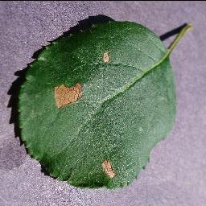
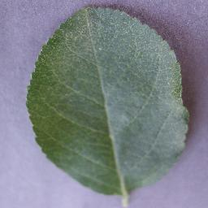
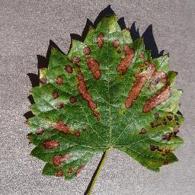
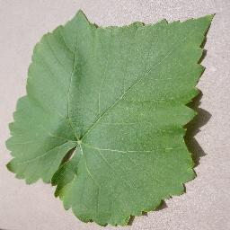
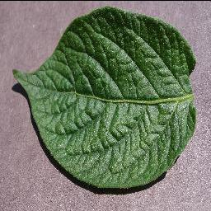
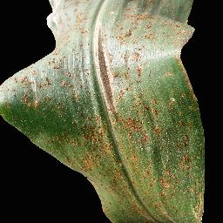
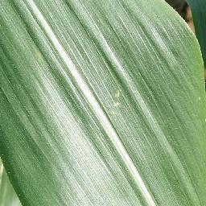
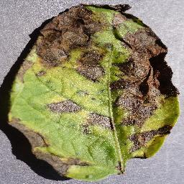
Suffered with Black rot
Healthy leaf of apple
Grape Esca (Black_Measles)
Healthy leaf of Grapes
Suffered with common rust
Healthy leaf of corn
Suffered with Early blight
Healthy leaf of Potato

Slide 18
FUTURE USAGE
As we know 85% crop disease are caused by fungus, bacteria, virus etc. and this is one of the main cause for the unavailability of healthy food or hunger.
As we know that technology plays a great role in this era, so we had technologies which can be a solution to our problem , Deep Convolutional Neural Networks(DCNN) has been successfully applied in various fields, we had also tried to eradicate the problem with the usage of this technology.
This technology has freshly moved in the domain of Just-In-Time crop disease detection and our aim is to develop an AI based crop disease detector using DCNN .
Through this farmers will be able to detect the problem at earlier stages and will get proper solution and suggestion from website.
In this way we will be able to produce healthy crop and can serve healthy food ,it’s a step towards eradicating hunger.

Slide 19
WHY WE CHOOSE WEB SERVICE AS A SOLUTION ?
Social media offers unprecedented access to cultivate relationships with customers, one at a time. For those who seek to build sustainable brands, social media should never take the place of the website as the ultimate destination of the brand.
66 percent use social media to learn about products and services.
Orchestrating Efforts Across Multiple Platforms is Easier When Pointing to One Destination: the Website.
Social media has become a vital aspect of an integrated marketing strategy.

Slide 20
THANK YOU

